Slide 1
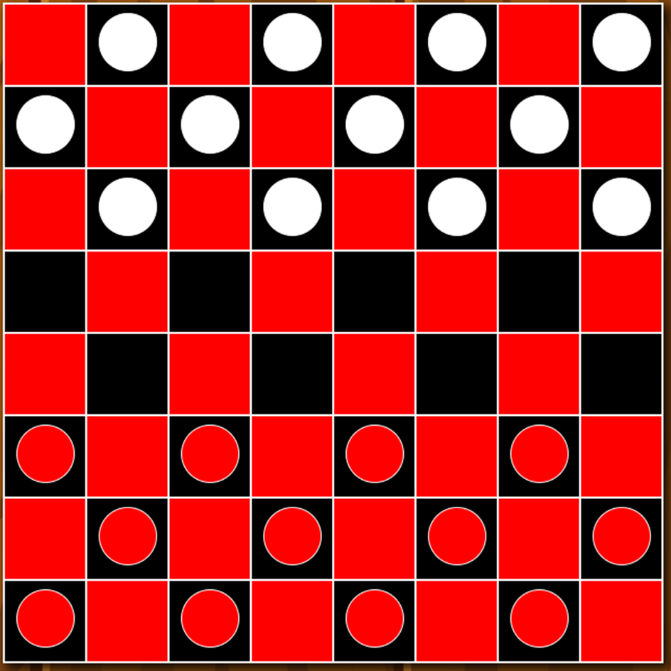
CIS 434 Course Project: Checkers Game
Group 12: Esmeralda Xhyliu, Tytionna Williams, Connor Van Etten

Slide 2
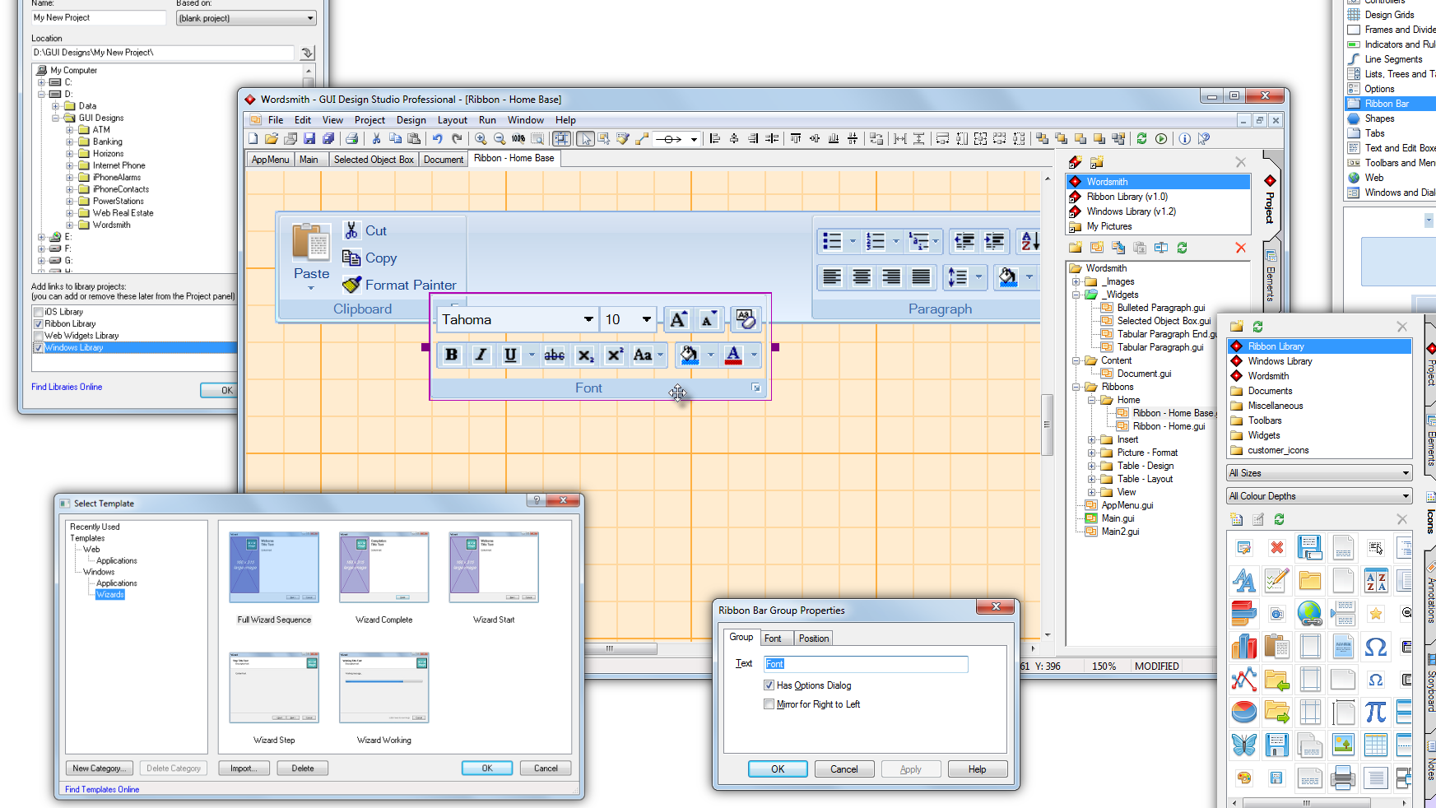
Project Objectives / Initial Goals
Create a Checkers game that allows users to play against one another, or against a ‘computer’ opponent
Computer opponent uses the given logic to respond to the user’s movement with the best possible moves
UI Focused Design
Reflect the game of Checkers
Board shape, colors and pieces
Competitive computer movements

Slide 3

Development Process
Transitioned from Water-Fall Model to an Incremental Model
changing to a less structured build was very beneficial
Many changes were made that affected the process
GUI to Web App
Designing had multiple stages
Several Reworks
Assessed each Process of Software development as we worked through our models
Requirements, Design, Testing and Validation, and Implementation

Slide 4
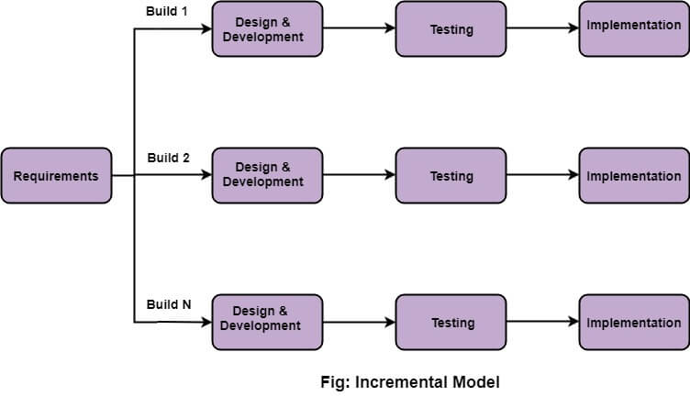
Incremental Model

Slide 5
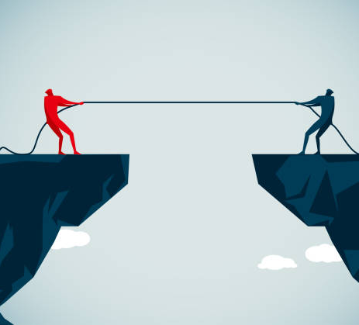
Challenges within Production
Consider both the audience and the team history
Juniors first project
Tunnel Vision or Lacking Group work
Often our habits of working alone kicked in
Time Complexities
Understanding each persons schedules
Unfamiliar With Languages
Javascript, CSS, HTML
GitHub Troubles
Overwrites, deletions, forgetting to commit
Tunnel Vision

Slide 6
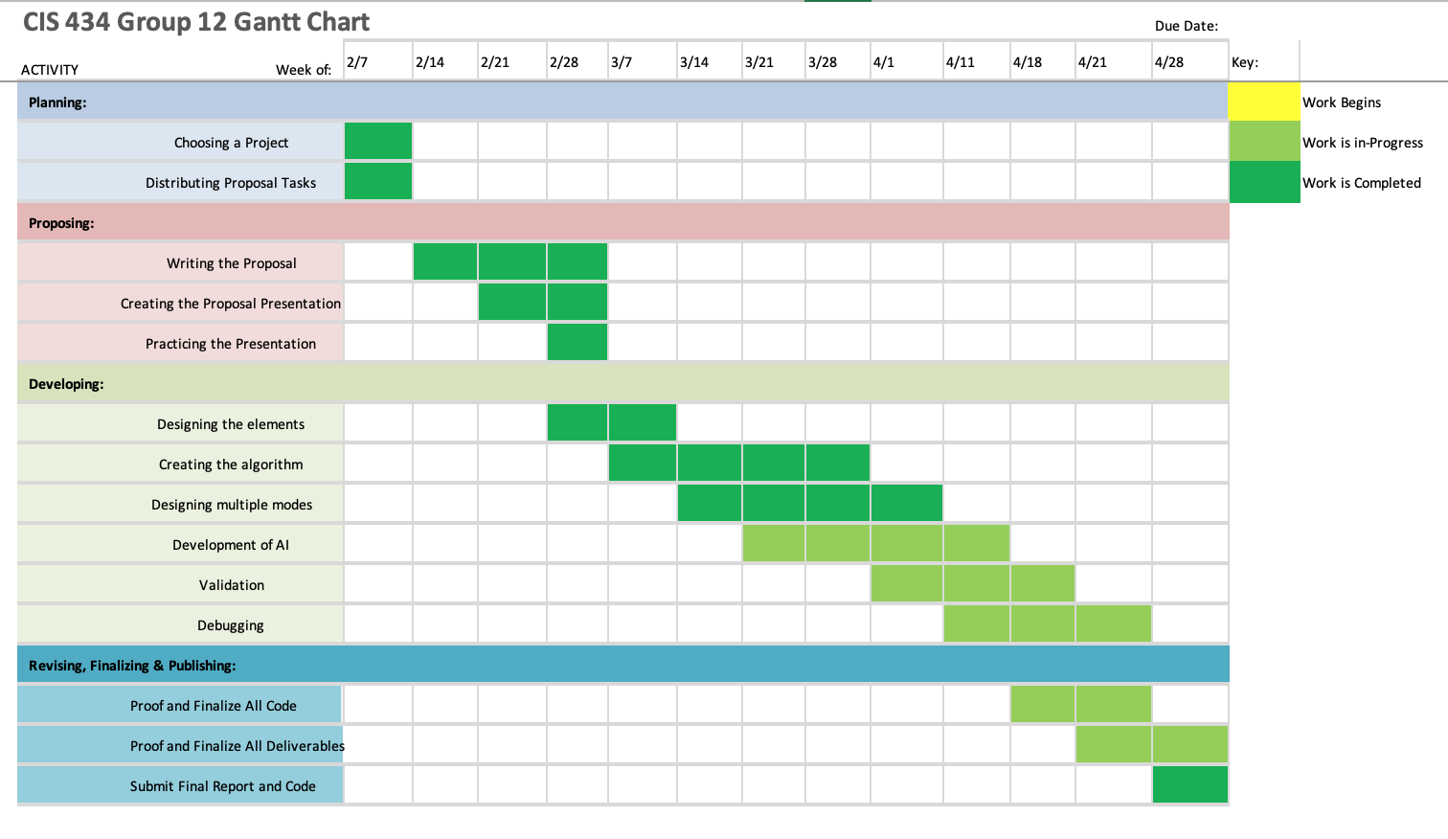
Timeline
Gantt Design Process
Includes a weekly view of when work started and completed for each stage of the project.
Transition from Water Fall model to Incremental Model
Easier to test and debug
More flexible

Slide 7

Project Description – Design Specifications
Main Menu contains 4 options:
Player vs Player
Player vs Computer (AI)
Checkers Rulebook
Quit
Both modes share the same game rules but will play slightly different
Player vs Computer mode: user will always start regardless of color
Player vs Player mode: user who is assigned red starts
Special Features in our Implementation
Move availability highlighting
Graphically seeing the pieces move
Visual Indication of turn

Slide 8
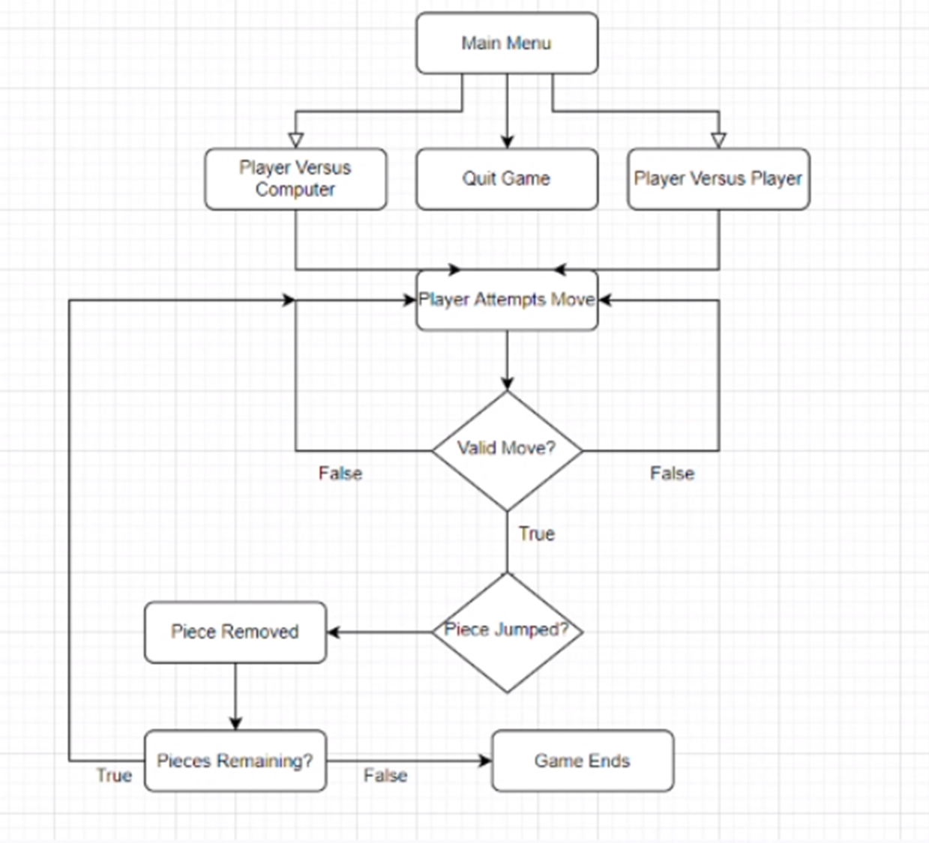
Code Logic
Use of HTML classes to create a table to “hold” our board
CSS gives us the color and visual representation
JavaScript gives the pulls the HTML elements and pieces and places them into an array.
Specified distances can then represent the surrounding cells or spaces
Multiple checks occur that include:
Turn
Color
Moves
Position

Slide 9
DEMO

Slide 10
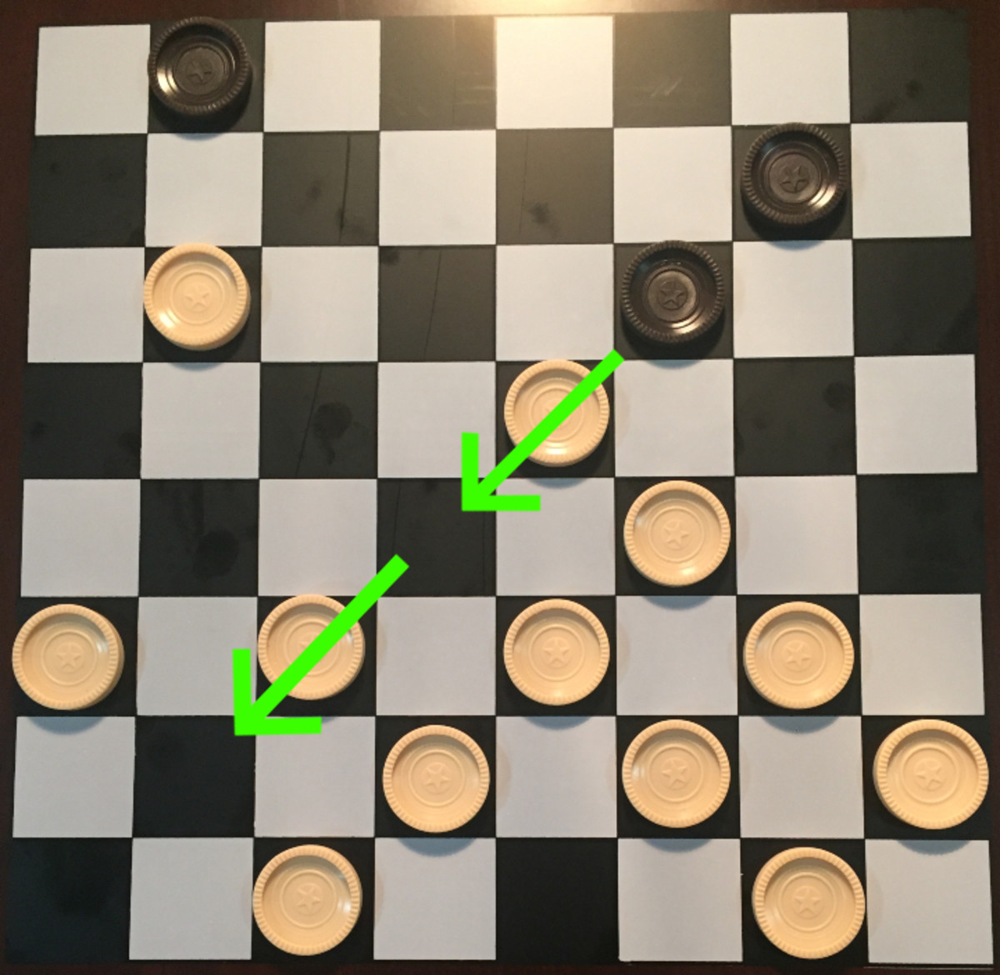
Conclusion
We implemented a Checkers game on an 8x8 board
Languages used:
HTML
CSS
JavaScript
Two modes:
Player vs Player
Player vs CPU (unfinished)

